Slide 1
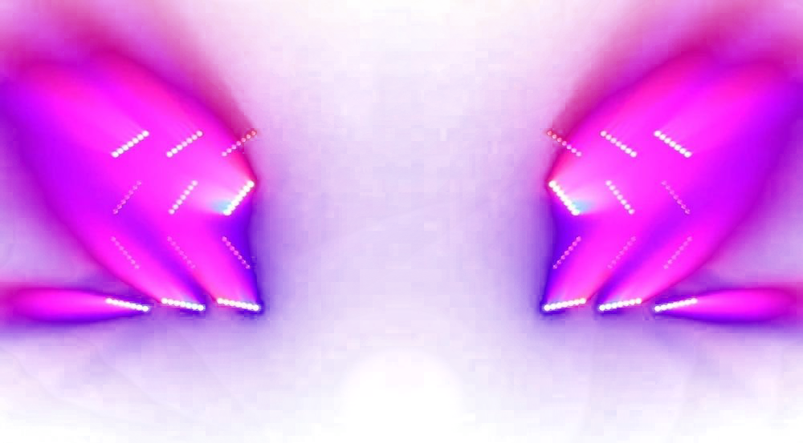


VR
Wotagei
Notice
Warning
Collection
new song Arrived
If you feel dizzy, stop playing the game
Now Play
If you continue to feel dizzy,
visit a hospital or doctor.
POP/stars – K/DA
replay
PLAY
Credit
2019 O.Y.O Soft Created

Slide 2

Notice
new song Arrived
Now Play
POP/stars – K/DA
replay
Credit
Collection
Mode Select
competion
mode
Solo PLAY
mode
Team play
mode
Compete with other players
in performance
Play Wotagei Alone
Play Wotagei with Other Players

Slide 3
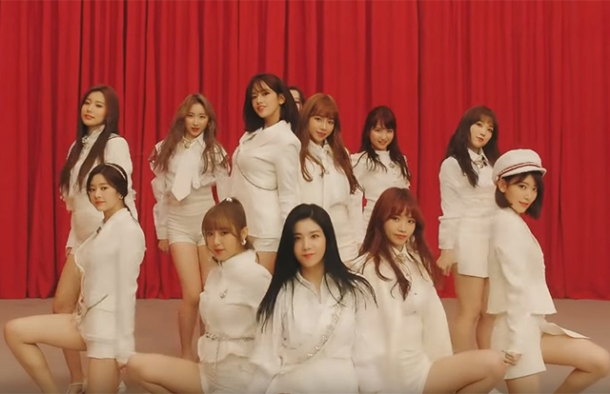





replay
Credit
Collection
Music Select
Ddu-du-ddu-du
Global ranking
Your play history
blackpink
ranking
username
score
pop/stars
date
score
rank
1
2
3
4
5
6
Nickname
Nickname
Nickname
Nickname
Nickname
nickname
000000
000000
000000
000000
000000
000000
k/da
2019/03/20
2019/03/20
2019/03/20
2019/03/20
2019/03/20
2019/03/20
000000
000000
000000
000000
000000
000000
SS
Ss
Ss
Ss
Ss
Ss
LA vie en rose
IZ*ONE
La vie en rose
Iz*one
Yes or yes
normal
HARD
twice
GAME STArt
Fake love
Click this button to play
bts

Slide 4
replay
Credit
Collection
Score 000,000
Game Result
A
Global ranking
details
ranking
username
score
Perfect
Great
Good
Bad
miss
000
000
000
000
000
1
2
3
4
5
6
Nickname
Nickname
Nickname
Nickname
Nickname
nickname
000000
000000
000000
000000
000000
000000
La vie en rose
rank
Iz*one
normal
HARD
Score 000,000
Go to music select
Best score 000,000
REtry
Combo 000x
replay
Best Combo 000x

Slide 5
000000
0 X

Slide 6
000000
0 X

Slide 7
000000
0 X

Slide 8
000000
0 X

Slide 9
000000
0 X

Slide 10
Spin!

Slide 11
